Slide 1
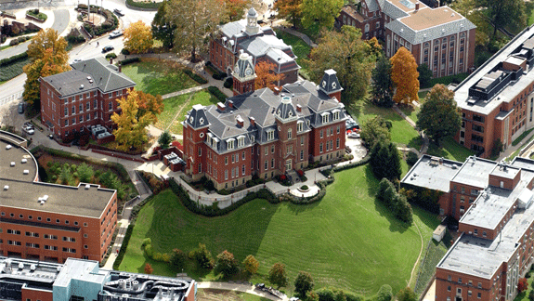

Slide 2
Alumni Summer Meeting
Casi Smith
Jacquie Gress
Office of Undergraduate Admissions

Slide 3
Spring Recruitment Events
Decide WVU Virtual Event
First large-scale virtual event
Over 800 students and parents in attendance
Feedback was very positive
Live sessions included
Paying for college
Residing on campus
Ask the Experts Panel
Pre-recorded sessions
Phone appointments Friday, Saturday & Monday
Junior Preview Day
Over 600 students attended
316 questions asked
Each session contained two parts:
Admissions Presentation
Tour Guide Live
Survey feedback included:
Warmth
Positivity
Contagious school spirit
89% extremely interested

Slide 4
Admitted Students Livestream Series
Format
Current Student Edition
Housing
Honors College, Undergraduate Research, Aspire
Student Support, Success & Wellness
Student Organizations & Campus Involvement
Facilitator and multiple moderators
Experts from corresponding departments on campus presenting
Regional recruiters assisted with questions about next steps, financial aid, etc.

Slide 5
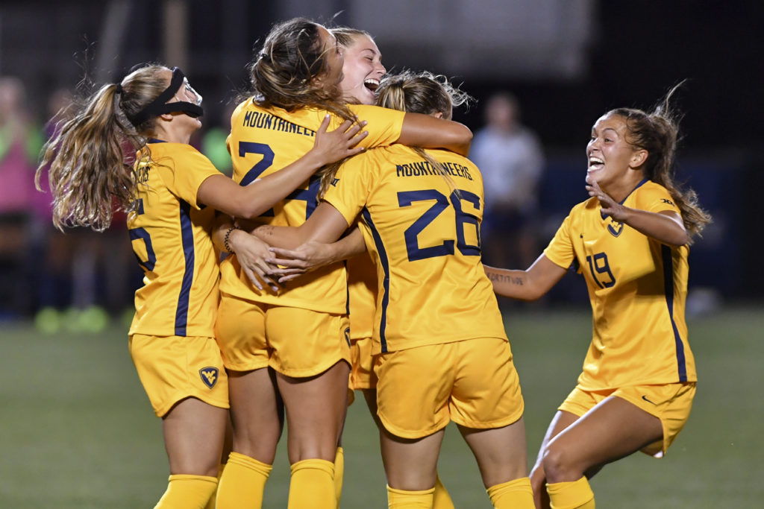
Ongoing Recruitment Events
Virtual High school visits
Livestreams
Multiple national and regional online college fairs
Department Zoom chats
Scheduled phone calls with regional recruiters
Scheduled phone calls with department faculty

Slide 6
New Student Orientation
Virtual Format
Three Mandatory Steps
Students complete online platform
Students meet with Orientation Leader
Students schedule courses with advisor
Other offerings available, such as virtual parent receptions, student-lead games & zoom sessions

Slide 7
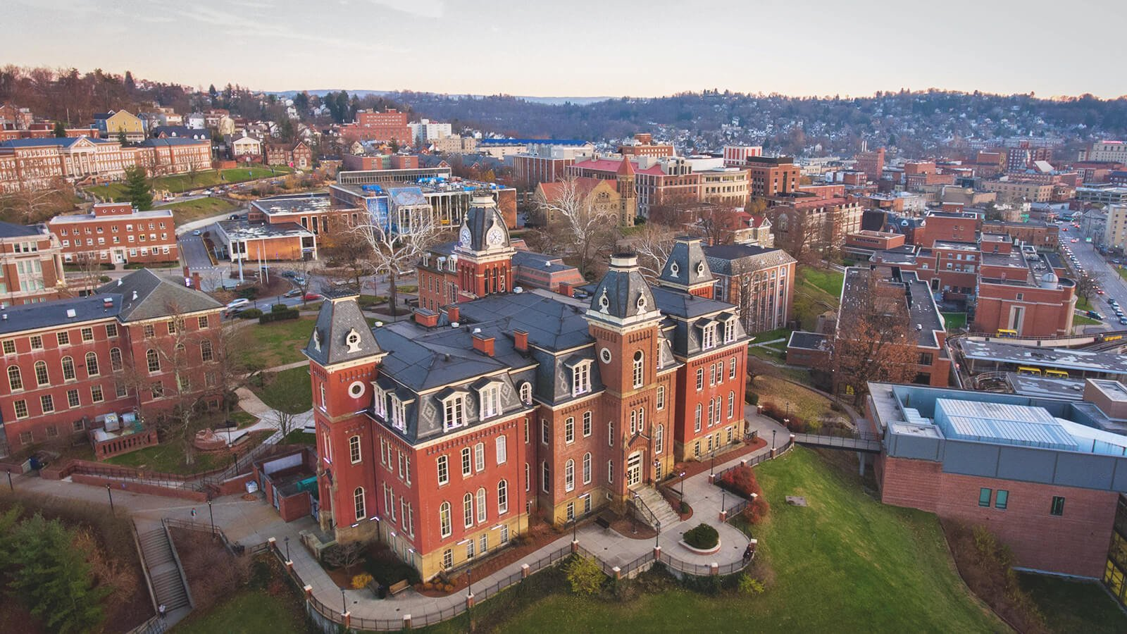
New Jersey applications are just about even in comparison to 2019
The number of admitted students has increased by about 1%
The number of deposits has increased by 1 %
Monmouth, Morris, Bergen, Essex, Gloucester, Atlantic, Somerset counties have had the most success in this admissions cycle.
Territory Management
New Jersey

Slide 8
Parents and students in New Jersey seem to be enthusiastic about joining us on campus in the fall as long as safeguards and a comprehensive plan is in full effect
Major concern is about pro-rated costs should students have to leave campus
Psychology, Forensic & Investigative Sciences, Criminology, Business are most popular majors
CPASS had surge in the Health & Well-being major
Territory Management
New Jersey

Slide 9
Preliminary Recruitment Expectations for Fall
Regionals are currently moving to a virtual contingency plan for fall
Contingency plan will still cover in-person visits
In person college national, regional and high school fairs are uncertain at this time
Some fair organizations are planning restricted in-person programming but are very uncertain if the fair will come to fruition
Visits to campus will be limited to small groups
Continue with Tour Guide Live series and virtual information sessions
Currently exploring Ask Us Anything format
Phone calls, note cards and other personalized recruitment endeavors will be necessary
Online Application
Be Admitted
Academic Deposit
Submit the FAFSA (Oct 1)
Housing Application
Orienation Registration
Notes:
Freshman Admissions Requirements: https://admissions.wvu.edu/admissions/university-requirements

Slide 10
On-campus Expectations
Classes will be a mix of in-person, hybrid and online formats
Intentional planning around testing, campus density and PPE, COVID isolation will guide decisions
Students will end classes for the semester on November 24
Masks will be required in classrooms
Classroom density goal is 50%
On-campus quarantine will be in effect for positive student cases
Student wellness and organizations will be provided with guidelines to create the best possible student experience
Online Application
Be Admitted
Academic Deposit
Submit the FAFSA (Oct 1)
Housing Application
Orienation Registration
Notes:
Freshman Admissions Requirements: https://admissions.wvu.edu/admissions/university-requirements

Slide 11
Thank you for Joining us!
Jacquelyn Gress
Jacquelyn.gress@mail.wvu.edu

Slide 12
Helpful Weblinks
COVID-19 Updates
Future Student Resources
Admitted Student Resources
Family Resources for Admitted Students
Graduate Admissions
Virtual New Student Orientation
Return to Campus Conversations
Return to Campus website
returntocampus@mail.wvu.edu

