Slide 1
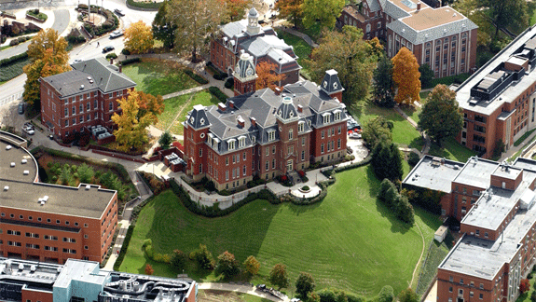

Slide 2
Alumni Summer Meeting
Kim McCarty
Office of Undergraduate Admissions

Slide 3
Spring Recruitment Events
Decide WVU Virtual Event
First large-scale virtual event
Over 800 students and parents in attendance
Feedback was very positive
Live sessions included
Paying for college
Residing on campus
Ask the Experts Panel
Pre-recorded sessions
Phone appointments Friday, Saturday & Monday
Junior Preview Day
Over 600 students attended
316 questions asked
Each session contained two parts:
Admissions Presentation
Tour Guide Live
Survey feedback included:
Warmth
Positivity
Contagious school spirit
89% extremely interested

Slide 4
Admitted Students Livestream Series – Offered Late Spring
Format
Current Student Edition
Housing
Honors College, Undergraduate Research, Aspire
Student Support, Success & Wellness
Student Organizations & Campus Involvement
Facilitator and multiple moderators
Experts from corresponding departments on campus presenting
Regional recruiters assisted with questions about next steps, financial aid, etc.

Slide 5
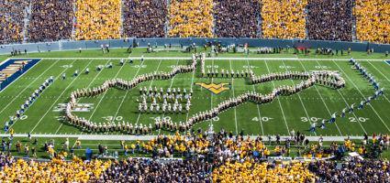
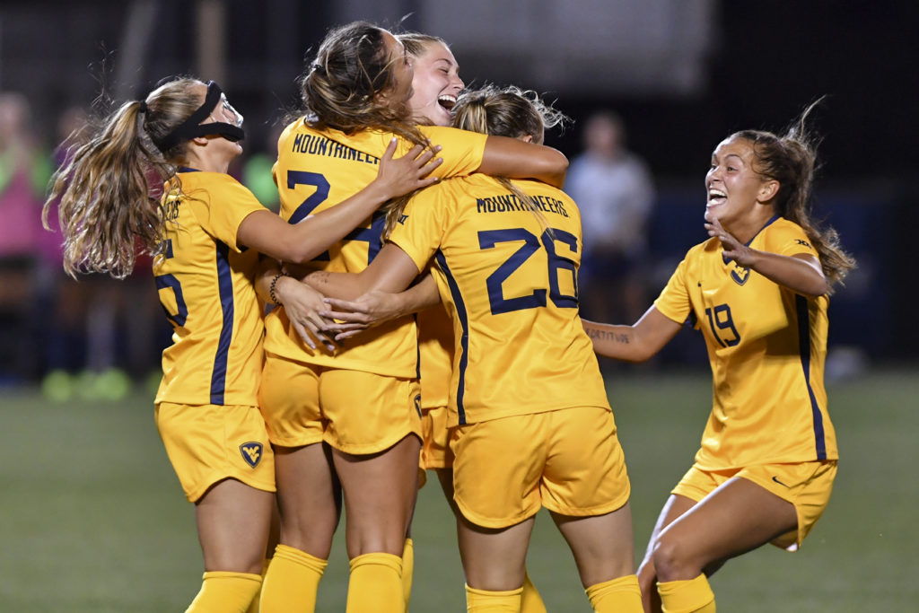
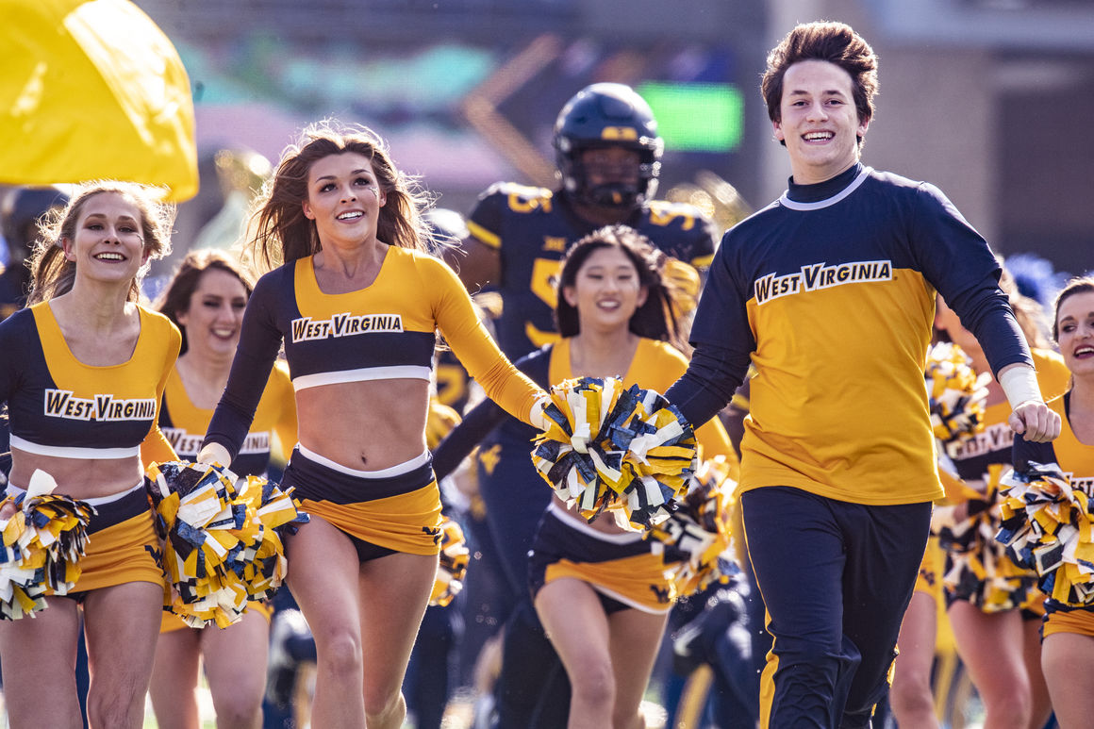
Ongoing Virtual Recruitment Events
Virtual High school visits
Student Programs and Academic Livestream Series
National and regional online college fairs
Academic department Zoom chats
Scheduled phone calls with regional recruiters
Scheduled phone calls with department faculty and student ambassadors

Slide 6
New Student Orientation
Virtual Format
Three Mandatory Steps
Students complete online platform
Students meet with Orientation Leader
Students schedule courses with advisor
Other offerings available, such as virtual parent receptions, student-lead games & zoom sessions

Slide 7
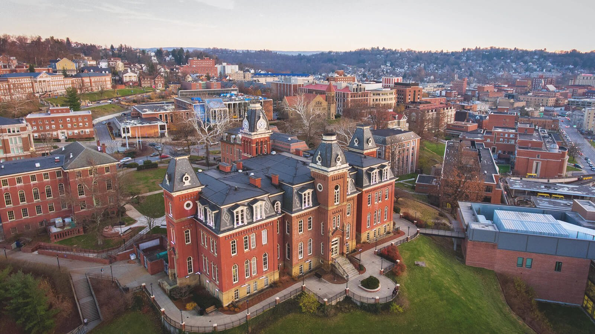
Applications and Committed Students
CO – 37/1
IL – 218/38
MI – 102/19
OH – 1222/257
Factors Influencing Above States
Cost, COVID-19, Distance, Home-State Measures
Ohio Reciprocity Agreement continues to be an attractive, cost-saving program
Fall 2020 First-Time Freshman Class
Mid-West

Slide 8
Preliminary Recruitment Expectations for Fall
Regionals are currently developing a virtual contingency plan for fall
National, regional and high school college fairs are uncertain at this time, although many have moved to virtual formats
The Visitors Centers are closed through September 7; the university will release more details later in July for campus visit options
Plan to continue virtual offerings, including Tour Guide Live, Admissions, and Ask Us Anything series
OGNB phone calls, note cards and other personalized recruitment endeavors are an important part of outreach and recruitment
Online Application
Be Admitted
Academic Deposit
Submit the FAFSA (Oct 1)
Housing Application
Orienation Registration
Notes:
Freshman Admissions Requirements: https://admissions.wvu.edu/admissions/university-requirements

Slide 9
On-campus Expectations
Classes start August 19; on-campus instruction ends November 24 and students transition to completing the term remotely
Classes will be a mix of in-person, hybrid and online formats
Planning around testing, campus density, PPE, COVID isolation will guide decisions
Masks will be required in classrooms
Classroom density goal is 50%
On-campus quarantine will be in effect for positive student cases
Student wellness and organizations will be provided with guidelines to create the best possible student experience
Online Application
Be Admitted
Academic Deposit
Submit the FAFSA (Oct 1)
Housing Application
Orienation Registration
Notes:
Freshman Admissions Requirements: https://admissions.wvu.edu/admissions/university-requirements

Slide 10
Thank you for Joining us!
Kim McCarty
kim.mccarty@mail.wvu.edu

Slide 11
Important Weblinks
COVID-19 Updates
Future Student Resources
Admitted Student Resources
Family Resources for Admitted Students
Graduate Admissions
Virtual New Student Orientation
Return to Campus Conversations
Return to Campus website
returntocampus@mail.wvu.edu

